Slide 1
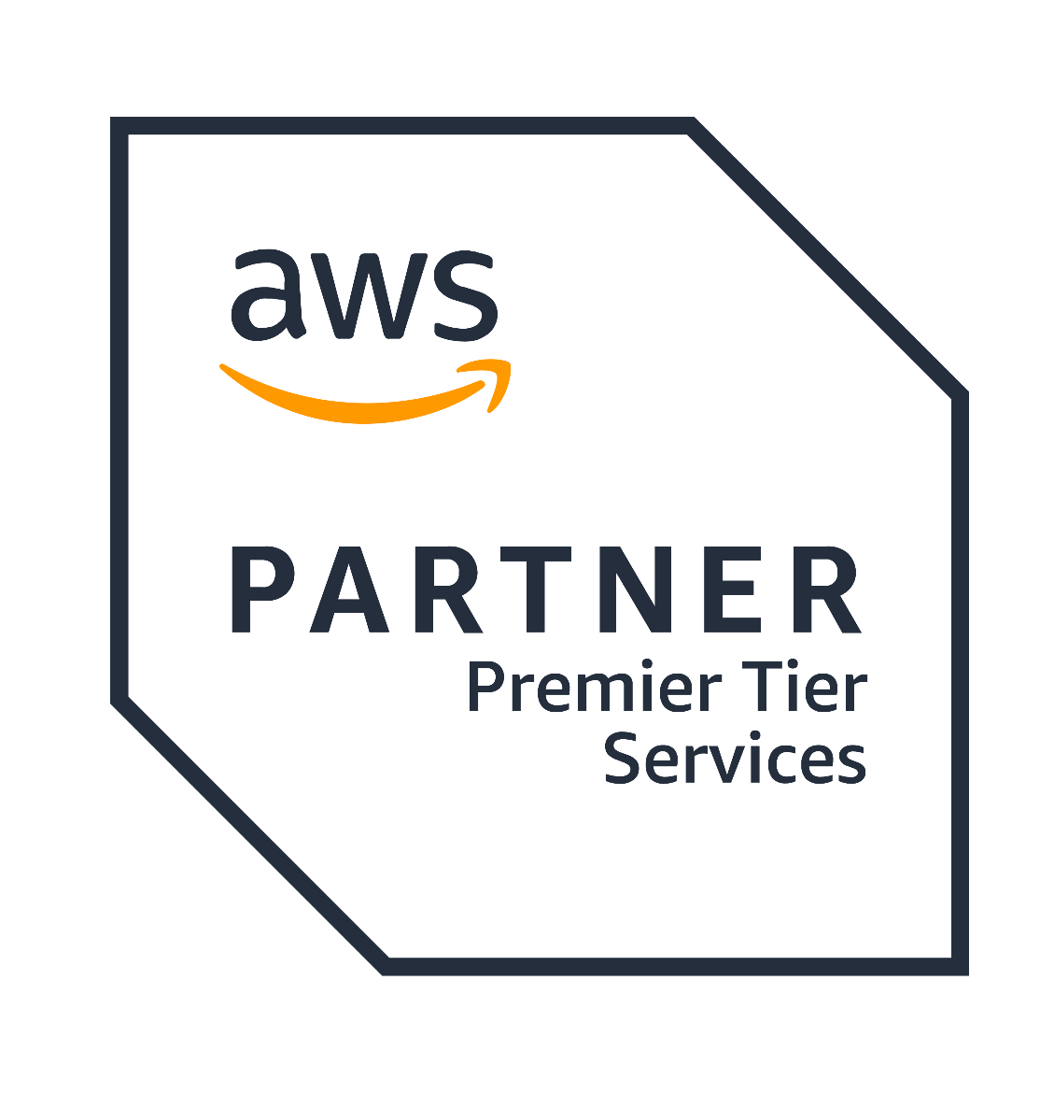


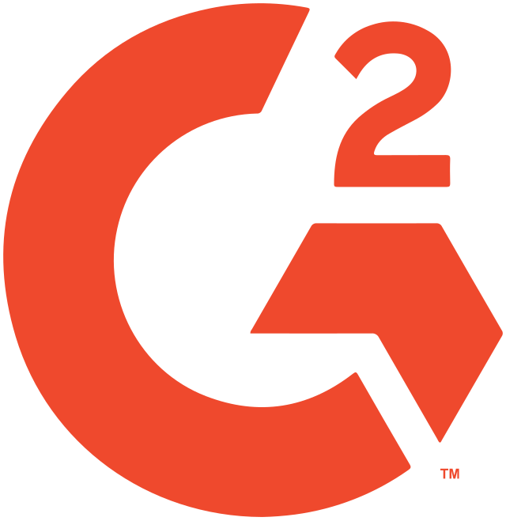




Dev Tools
Proudly recognized by

Slide 2
Introduction
Postman
DB Tools (Dbeaver + Workbench + MongoDB Compass)
IDE ( IntelliJ)
Build Tool (Gradle)
Exercise
Q&A
Agenda

Slide 3
Introduction
Dev tools are programs and technologies designed to make software development faster, easier, and more reliable.
Common types include code editors, IDEs, version control systems (e.g., Git), build tools (e.g., Gradle), debugging tools, and collaboration software.
Examples: Visual Studio Code, IntelliJ IDEA, GitHub, Chrome DevTools, Docker, Jenkins, Slack.
They provide a foundation for all coding and testing activities—knowing how to use them increases productivity and reduces manual errors.
Dev tools help automate common development tasks such as building, deploying, and testing code, saving time and minimizing mistakes.
Effective use of these tools enhances collaboration within teams, manages code versioning, and detects bugs early, which improves software quality and maintainability.
Understanding the right tools also helps you select the best approach for each stage of development, reducing learning curves and making the whole process smoother

Slide 4
Postman
API platform for building, testing, and managing APIs
Request building with intuitive interface
Environment setup and variable management
Collection management and collaboration
Automation: scripting, testing, monitoring APIs
Visualization tools and documentation support

Slide 5
DB Tools
DBeaver :
Universal, open-source DB tool supporting 100+ databases (SQL, NoSQL, cloud). Ideal for users working with varied database types or planning to expand beyond MySQL.
Features: Visual Query Builder, AI SQL Assistant, advanced data transfer options, semantic SQL analysis, multi-tab interface.
Data migration and import/export: supports multiple file formats and direct table transfers.
MySQL Workbench:
Specialized GUI designed for MySQL database management. Best for users focused exclusively on MySQL or migrating to MySQL.
Features: Powerful data modeling, ER diagrams, forward/reverse engineering, migration wizard for ODBC databases.
Import/export supports CSV natively, more formats require custom queries.

Slide 6
DB Tools
MongoDB Compass :
Official GUI for MongoDB databases; highly visual and intuitive.
Features: schema visualization, graphical query builder, aggregation pipeline designer, real-time performance monitoring, index management, document validation, data import/export.
Enables interactive exploration and management without requiring deep MongoDB Shell expertise.

Slide 7
IDE(IntelliJ)
Smart code completion, context-aware error detection, and live code analysis.
Advanced refactoring tools for safe, automated code changes.
Integrated debugging, test runners, and code coverage analysis.
Seamless version control integration (Git, SVN, Mercurial) for easy code collaboration and tracking.
Built-in database tools and diagramming (“Database” tab for direct query and data source management).
Vast plugin ecosystem for expanded frameworks, languages, and utility features.
Customizable user interface with themes and keyboard shortcuts.
Regular updates and support; Community (free) and Ultimate (paid) editions.
Strong AI/ML-assisted suggestions that accelerate coding and reduce errors.

Slide 8
Build Tool (Gradle)
Incremental builds and build caching—only recompiles code that’s changed, speeding up build times dramatically.
Flexible scripting with Groovy or Kotlin Domain Specific Language (DSL) for custom automation.
Efficient dependency management—resolves, downloads, and updates project dependencies automatically from Maven/IVY repositories.
Supports multi-project builds and complex project structures for large-scale development.
Wide plugin ecosystem—extends Gradle for Android, Java, C++, Scala, Spring, and many more technologies.
Easy integration with popular IDEs (IntelliJ, Eclipse, Android Studio) for seamless developer workflows.
Automated test execution, code coverage, and reporting with support for JUnit, TestNG, and Spock.
Continuous integration: integrates easily with CI/CD platforms like Jenkins and TeamCity.
Cross-platform open-source project under the Apache License.

Slide 9
Exercise
Create a collection in postman with get and post apis where base url will be saved in environment variable.
Connect your local database with your Db tool like DBeaver/ Workbench and try running scripts, export and import data, check the query tuning option.
Practice debugging the java code with IntelliJ debugger, try and get handy with evaluator.

Slide 10
Thank You

